Slide 1
Unit 5
Data Mining Techniques

Slide 2
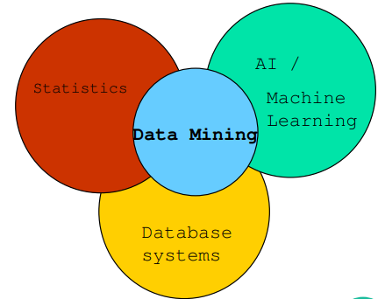
Origins of Data Mining
Draws ideas from machine learning/AI, pattern recognition, statistics, and database systems
Must address:
Greatness of data
High dimensionality
of data
Heterogeneous,
distributed nature
of data

Slide 3
Data Quality
Data have quality if they satisfy the requirements of the intended use.
There are many factors comprising data quality, including accuracy, completeness, consistency, timeliness, believability, and interpretability.

Slide 4
Factor affecting Accuracy, Completeness, and Consistency.
Having incorrect attribute values.
The data collection instruments used may be faulty.
Human or computer errors occurring at data entry.
Users may purposely submit incorrect data values for mandatory fields when they do not wish to submit personal information (e.g., by choosing the default value “January 1” displayed for birthday). This is known as disguised missing data.
Errors in data transmission.
Technology limitations such as limited buffer size for coordinating synchronized data transfer and consumption.
Incorrect data may also result from inconsistencies in naming conventions or data codes, or inconsistent formats for input fields (e.g., date).

Slide 5
Why Data Preprocessing?
Data in the real world is dirty
– incomplete: lacking attribute values, lacking certain attributes of interest, or containing only aggregate data
– noisy: containing errors or outliers
– inconsistent: containing discrepancies in codes or names
● No quality data, no quality mining results!
– Quality decisions must be based on quality data
– Data warehouse needs consistent integration of quality data
– Required for both OLAP and Data Mining!

Slide 6
Why can Data be Incomplete?
Attributes of interest are not available (e.g., customer information for sales transaction data)
Data were not considered important at the time of transactions, so they were not recorded!
Data not recorded because of misunderstanding or malfunctions
Data may have been recorded and later deleted!
Missing/unknown values for some data

Slide 7
Major Tasks in Data Preprocessing
Data cleaning routines work to “clean” the data by filling in missing values, smoothing noisy data, identifying or removing outliers, and resolving inconsistencies.
Data integration : This would involve integrating multiple databases, data cubes, or files
Data reduction obtains a reduced representation of the data set that is much smaller in volume, yet produces the same (or almost the same) analytical results.

Slide 8
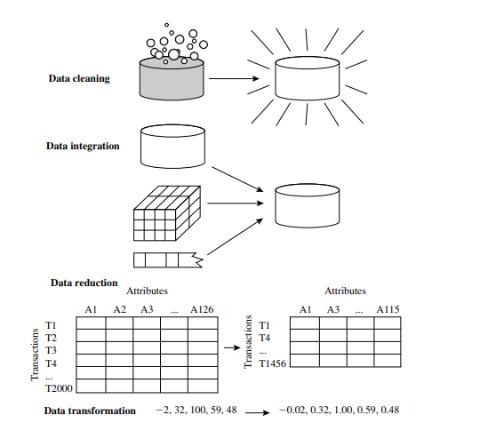
Forms of DPP

Slide 9
Data Cleaning
a) Missing Values:-
How can you go about filling in the missing values for particular attribute?
Ignore the tuple:- usually done when the class label is missing (assuming the mining task involves classification)
Fill in the missing value manually:- time consuming and may not be feasible given a large data set with many missing values
Use a global constant to fill in the missing value:-Replace all missing attribute values by the same constant such as a label like “Unknown” or −∞

Slide 10
4. Use a measure of central tendency for the attribute (e.g., the mean or median) to fill in the missing value:- . For normal (symmetric) data distributions, the mean can be used, while skewed data distribution should employ the median
5. Use the attribute mean or median for all samples belonging to the same class as the given tuple:- For example, if classifying customers according to credit risk, we may replace the missing value with the mean income value for customers in the same credit risk category as that of the given tuple. If the data distribution for a given class is skewed, the median value is a better choice.
6. Use the most probable value to fill in the missing value:- This may be determined with regression, inference-based tools using a Bayesian formalism, or decision tree.

Slide 11
Noisy Data
Noise is a random error or variance in a measured variable
Detection of Noise:- Basic statistical description techniques and methods of data visualization
Data Smoothing Techniques
Binning:
Smooth a sorted data value by consulting its “neighborhood,” i.e. the values around it.
The sorted values are distributed into a number of “buckets,” or bins.
a. smoothing by bin means
b. smoothing by bin medians
c. smoothing by bin boundaries

Slide 12
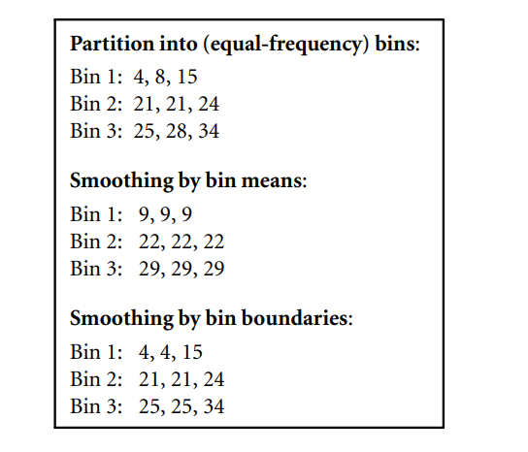
Sorted data for price (in dollars): 4, 8, 15, 21, 21, 24, 25, 28, 34

Slide 13
2. Regression:
A technique that conforms data values to a function.
Linear regression involves finding the “best” line to fit two attributes (or variables) so that one attribute can be used to predict the other.
Multiple linear regression is an extension of linear regression, where more than two attributes are involved and the data are fit to a multidimensional surface.
3. Outliers
May be detected by clustering, for example, where similar values are organized into groups, or “clusters.”
Values that fall outside of the set of clusters may be considered outliers.

Slide 14
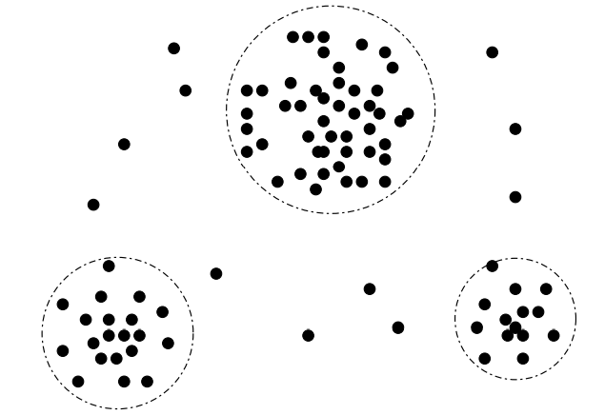
Outliers may be detected as values that fall outside of the cluster sets.

Slide 15
Data Integration
Merging of data from multiple data stores.
In the resulting data set, Careful integration can help reduce and avoid redundancies and inconsistencies.
How can we match schema and objects from different sources?
Are any attributes correlated?
Issue in Data Integration
entity identification problem:-
How can equivalent real-world entities from multiple data sources be matched up?
For example, how can the data analyst or the computer be sure that customer id in one database and cust number in another refer to the same attribute?
Solution→ Schema integration:-
Attention must be paid to the structure of the data.
Functional dependencies and referential constraints in the source system

Slide 16
b. Redundancy and Correlation Analysis:-
Some redundancies can be detected by correlation analysis
Given two attributes, such analysis can measure how strongly one attribute implies the other, based on the available data.
For nominal data, we use the χ 2 (chi-square) test.
For numeric attributes, we can use the correlation coefficient and covariance, both of which access how one attribute’s values vary from those of another.

Slide 17
c. Tuple Duplication
Duplication should also be detected at the tuple level
The use of denormalized tables is another source of data redundancy.
Due to inaccurate data entry or updating some but not all data occurrences.
d. Data Value Conflict Detection and Resolution
Due to differences in representation, scaling, or encoding

Slide 18
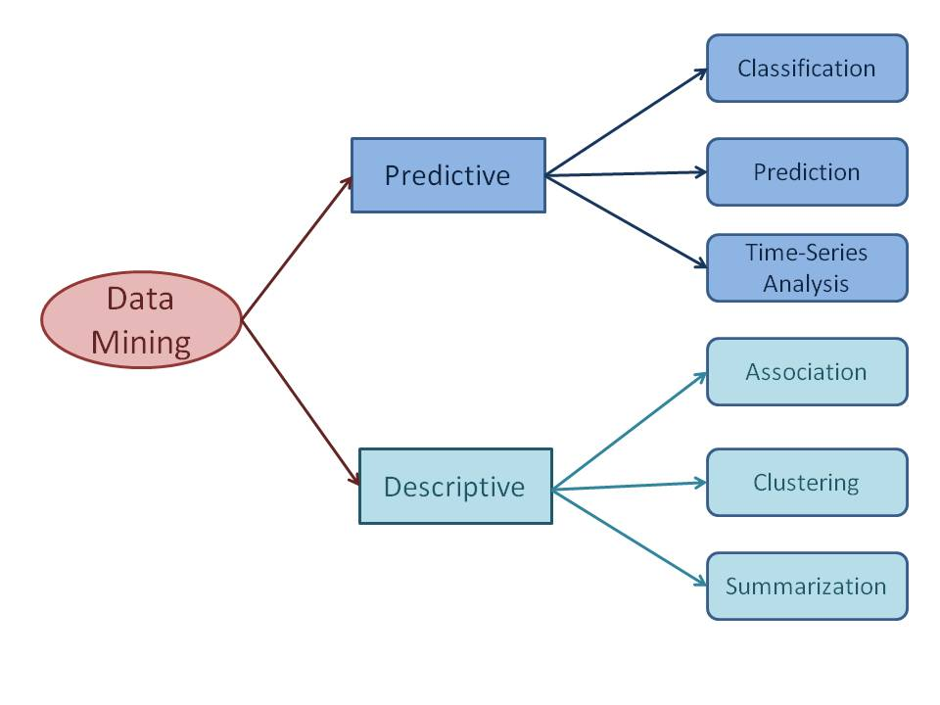
Data Mining Tasks

Slide 19
Classification: Definition
Given a collection of records (training set )
– Each record contains a set of attributes, one of the attributes is the class.
● Find a model for class attribute as a function of the values of other attributes.
● Goal: previously unseen records should be assigned a class as accurately as possible.
– A test set is used to determine the accuracy of the model.
Usually, the given data set is divided into training and test sets, with training set used to build the model and test set used to validate it.

Slide 20
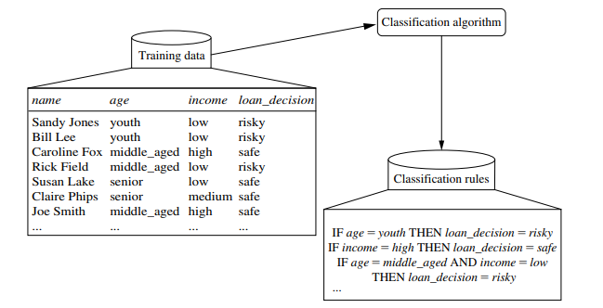
How does classification work?
a. Learning step (or Training phase):- Training data are analyzed by a classification algorithm. Here, the class label attribute is loan decision, and the learned model or classifier is represented in the form of classification rules

Slide 21
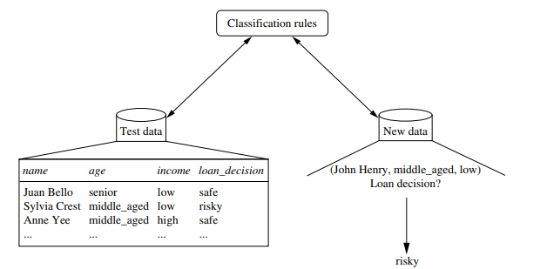
b. classification step:-
Model is used to predict class labels for given data
Test data are used to estimate the accuracy of the classification rules. If the accuracy is considered acceptable, the rules can be applied to the classification of new data tuples.

Slide 22
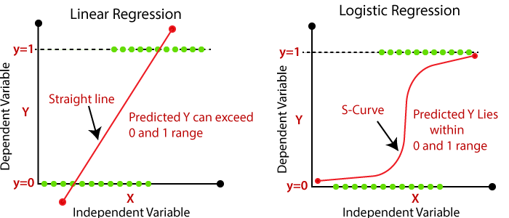
Regression
For the purpose of predicting a range of continuous values (which can also be called “numeric values”) in a specific data set.
For example, Regression can predict sales, profits, temperature, distance and so on.
Linear Regression vs Logistic Regression

Slide 23
S.N | Linear Regression | Logistic Regression
1 | To predict the continuous dependent variable using a given set of independent variables. | To predict the continuous dependent variable using a given set of independent variables.
2 | Used for solving Regression problem. | Used for solving Classification problems.
3 | We find the best fit line, by which we can easily predict the output. | We find the S-curve by which we can classify the samples.
4 | The output for Linear Regression must be a continuous value, such as price, age, etc | The output of Logistic Regression must be a Categorical value such as 0 or 1, Yes or No, etc.

Slide 24
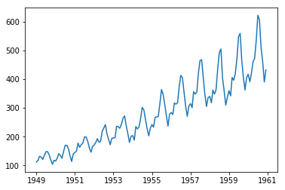
Time Series Analysis
Time series is a sequence of events where the next event is determined by one or more of the preceding events.
Time series reflects the process being measured and there are certain components that affect the behavior of a process.
Time series analysis includes methods to analyze time-series data in order to extract useful patterns, trends, rules and statistics.
Stock market prediction is an important application of time- series analysis.

Slide 25
Summarization
Summarization is the generalization of data.
A set of relevant data is summarized which result in a smaller set that gives aggregated information of the data.
For example, the shopping done by a customer can be summarized into total products, total spending, offers used, etc.
Such high level summarized information can be useful for sales or customer relationship team for detailed customer and purchase behavior analysis.

Slide 26
Clustering
Given a set of data points, each having a set of attributes, and a similarity measure among them, find clusters such that
– Data points in one cluster are more similar to one another.
– Data points in separate clusters are less similar to one another.
● Similarity Measures:
– Euclidean Distance if attributes are continuous. – Other Problem-specific Measures.

Slide 27
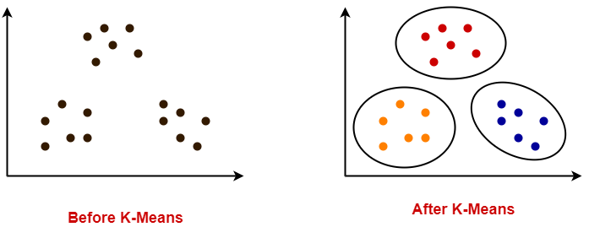
Illustrating Clustering
Euclidean Distance Based Clustering in 3-D space.
Intra-cluster distance
is minimized
Inter-cluster distance
is maximized
Example:- K-Means Clustering

Slide 28
Data Mining Methods
1. Decision Tree Classifiers: Used for modeling, classification
2. Association Rules: Used to find associations between sets of attributes
3. Sequential patterns: Used to find temporal associations in time series
4. Hierarchical clustering: used to group customers, web users, etc

Slide 29
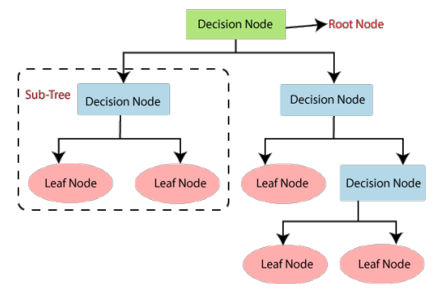
Decision Tree Classifiers
Decision Tree is a supervised learning technique that can be used for both classification and Regression problems, but mostly it is preferred for solving Classification problems.
It is a tree-structured classifier, where internal nodes represent the features of a data set, branches represent the decision rules and each leaf node represents the outcome.

Slide 30
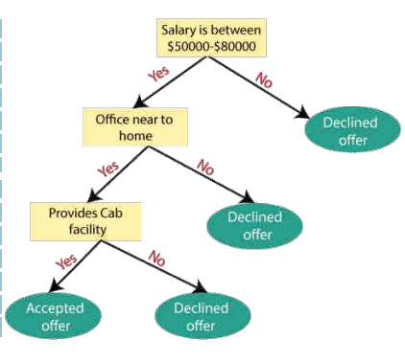
Decision Tree Classifiers → Example
Suppose there is a candidate who has a job offer and wants to decide whether he should accept the offer or Not. So, to solve this problem, the decision tree starts with the root node (Salary attribute by ASM). The root node splits further into the next decision node (distance from the office) and one leaf node based on the corresponding labels. The next decision node further gets split into one decision node (Cab facility) and one leaf node. Finally, the decision node splits into two leaf nodes (Accepted offers and Declined offer).

Slide 31
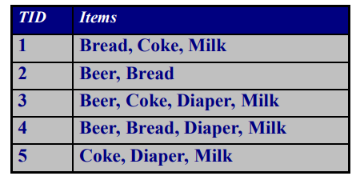
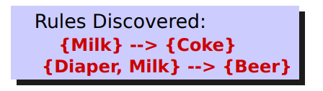
Association Rule Learning
Association rule learning is a type of unsupervised learning technique that checks for the dependency of one data item on another data item and maps accordingly so that it can be more profitable.
It tries to find some interesting relations or associations among the variables of data set.

Slide 32
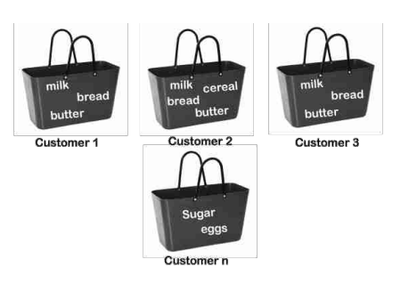
Association Rule Learning → Example
For example, if a customer buys bread, he most likely can also buy butter, eggs, or milk, so these products are stored within a shelf or mostly nearby.

Slide 33
Market Basket Analysis
Association rules are used to predict the likelihood of products being purchased together.
Association rules count the frequency of items that occur together, seeking to find associations that occur far more often than expected.
An example of Association Rules
Assume there are 100 customers
10 of them bought milk, 8 bought butter and 6 bought both of them.
bought milk => bought butter
support = P(Milk & Butter) = 6/100 = 0.06
confidence = support/P(Butter) = 0.06/0.08 = 0.75
lift = confidence/P(Milk) = 0.75/0.10 = 7.5

Slide 34
Association Rule Learning → Application
Medical Diagnosis: Using relational association rule mining, we can identify the probability of the occurrence of illness concerning various factors and symptoms.
Further, using learning techniques, this interface can be extended by adding new symptoms and defining relationships between the new signs and the corresponding diseases.

Slide 35
Sequential Pattern Mining
For analyzing sequential data, to discover sequential patterns.
It consists of discovering interesting subsequences in a set of sequences, where the interestingness of a subsequence can be measured in terms of various criteria such as its occurrence frequency, length, and profit.
Application:- bioinformatics, e-learning, market basket analysis, texts, and webpage click-stream analysis.

Slide 36
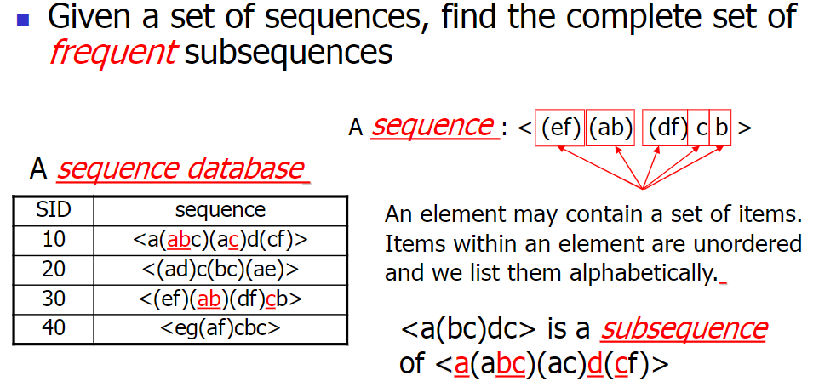

Sequential Pattern Mining

Slide 37
Challenges on Sequential Pattern Mining
A huge number of possible sequential patterns are hidden in databases
A mining algorithm should
– find the complete set of patterns, when possible, satisfying the minimum support threshold
– be highly efficient, scalable, involving only a small number of database scans
– be able to incorporate various kinds of user specific constraints

Slide 38
Hierarchical Clustering
Hierarchical clustering refers to an unsupervised learning procedure that determines successive clusters based on previously defined clusters.
It works via grouping data into a tree of clusters.
The endpoint refers to a different set of clusters, where each cluster is different from the other cluster, and the objects within each cluster are the same as one another.

Slide 39
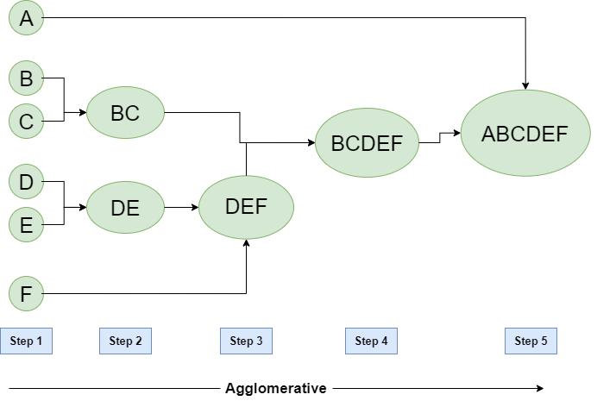
There are two types of hierarchical clustering
Agglomerative Hierarchical :- Each data point act as an individual cluster and at each step, data objects are grouped in a bottom-up method. Initially, each data object is in its cluster.

Slide 40
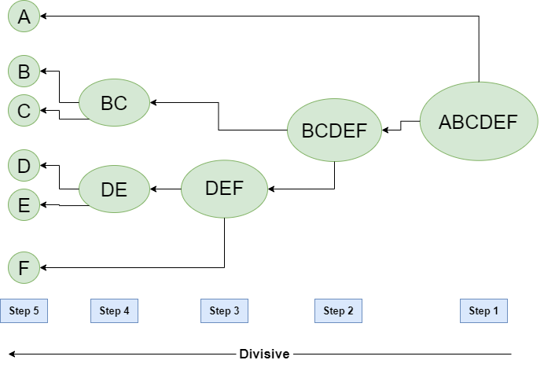
In Divisive Hierarchical:- we take into account all of the data points as a single cluster and in every iteration, we separate the data points from the clusters which aren’t comparable. In the end, we are left with N clusters.

Slide 41
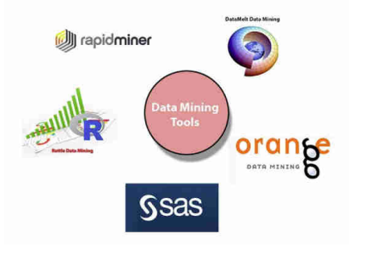
Data Mining Tools
Data Mining tools have the objective of discovering patterns/ trends/groupings among large sets of data and transforming data into more refined info.

Slide 42

Data Mining Tools → Orange Data Mining
It supports the visualization and is a software-based on components written in Python computing language and developed at the bioinformatics laboratory at the faculty of computer and information science, Ljubljana University, Slovenia.
As it is a software-based on components, the components of Orange are called "widgets." These widgets range from preprocessing and data visualization to the assessment of algorithms and predictive modeling.

Slide 43
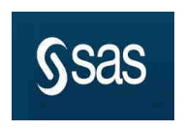
Data Mining Tools → SAS
SAS stands for Statistical Analysis System. It is a product of the SAS Institute created for analytics and data management. SAS can mine data, change it, manage information from various sources, and analyze statistics. It offers a graphical UI for non-technical users.
SAS data miner allows users to analyze big data and provide accurate insight for timely decision-making purposes.

Slide 44

Data Mining Tools → Data Melt Data Mining
Data Melt is a computation and visualization environment which offers an interactive structure for data analysis and visualization. It is primarily designed for students, engineers, and scientists. It is also known as Dmelt.
DMelt is a multi-platform utility written in JAVA. It can run on any operating system which is compatible with JVM (Java Virtual Machine).
It consists of Science and mathematics libraries.

Slide 45
Data Mining Tools → Rattle
Ratte is a data mining tool based on GUI. It uses the R stats programming language.
Rattle exposes the statical power of R by offering significant data mining features.
Data Mining Tools → Rapid Miner
Rapid Miner is one of the most popular predictive analysis systems created by the company with the same name as the Rapid Miner.
It is written in JAVA programming language.
It offers an integrated environment for text mining, deep learning, machine learning, and predictive analysis

